Slide 1
Inverse reinforcement learning

Slide 2
Toward Diverse Text Generation with Inverse Reinforcement Learning
No metrics are perfect: Adversarial Reward Learning for Visual Storytelling
Counterfactual Multi-Agent Policy Gradient
Multi-Agent Actor-Critic for Mixed Cooperative-Competitive Environments

Slide 3







Toward Diverse Text Generation with Inverse Reinforcement Learning
Reward Approximator
Boltzmann exploration：

Slide 4

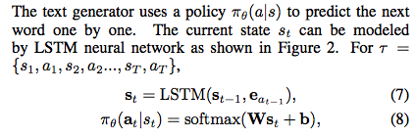




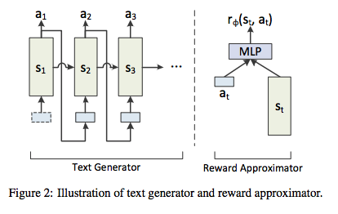
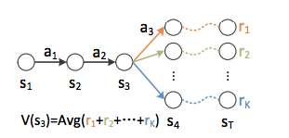
Toward Diverse Text Generation with Inverse Reinforcement Learning
Text Generator

Slide 5
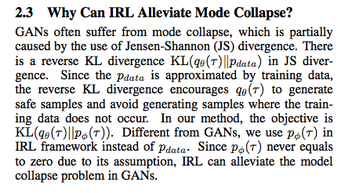
Toward Diverse Text Generation with Inverse Reinforcement Learning
Notes:
KL-annealing ？？？？

Slide 6
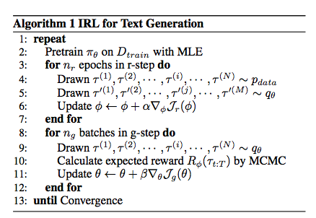
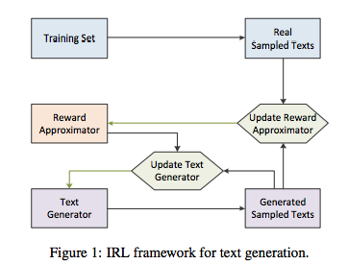

Toward Diverse Text Generation with Inverse Reinforcement Learning

Slide 7
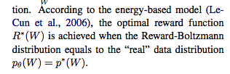
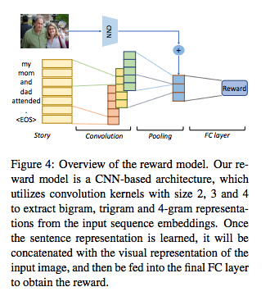

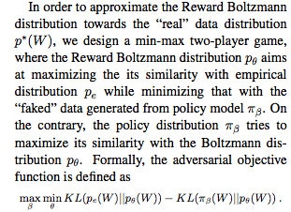
No metrics are perfect: Adversarial Reward Learning for Visual Storytelling

Slide 8
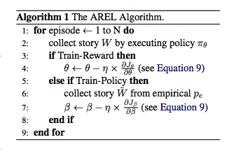
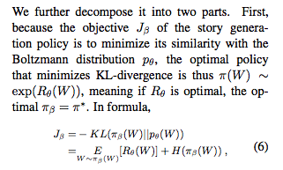



No metrics are perfect: Adversarial Reward Learning for Visual Storytelling

Slide 9
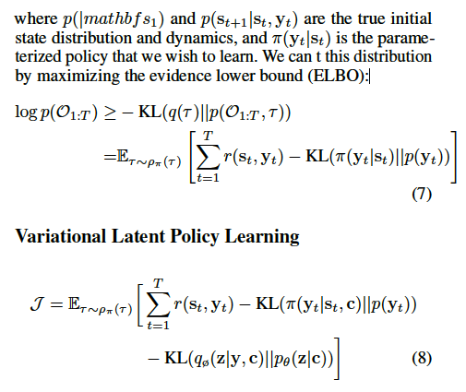

Slide 11
Counterfactual Multi-Agent Policy Gradient

